Slide 1
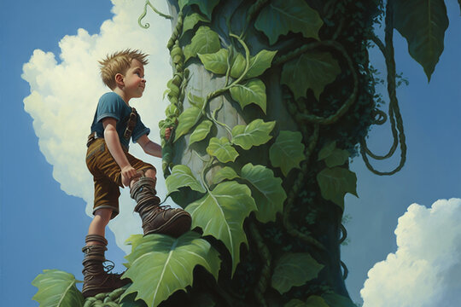
JACK AND THE BEANSTALK
5PM THURSDAY 28TH DECEMBER 2023 AT ABERTYSSWG WORKING MENS CLUB
TICKETS £5.00. AVAILABLE VIA LORRAINE GRONOW
Part-Sponsored by Rhymney Community Council
Merry Christmas and a Happy New Year from your local Community Council

